Slide 1
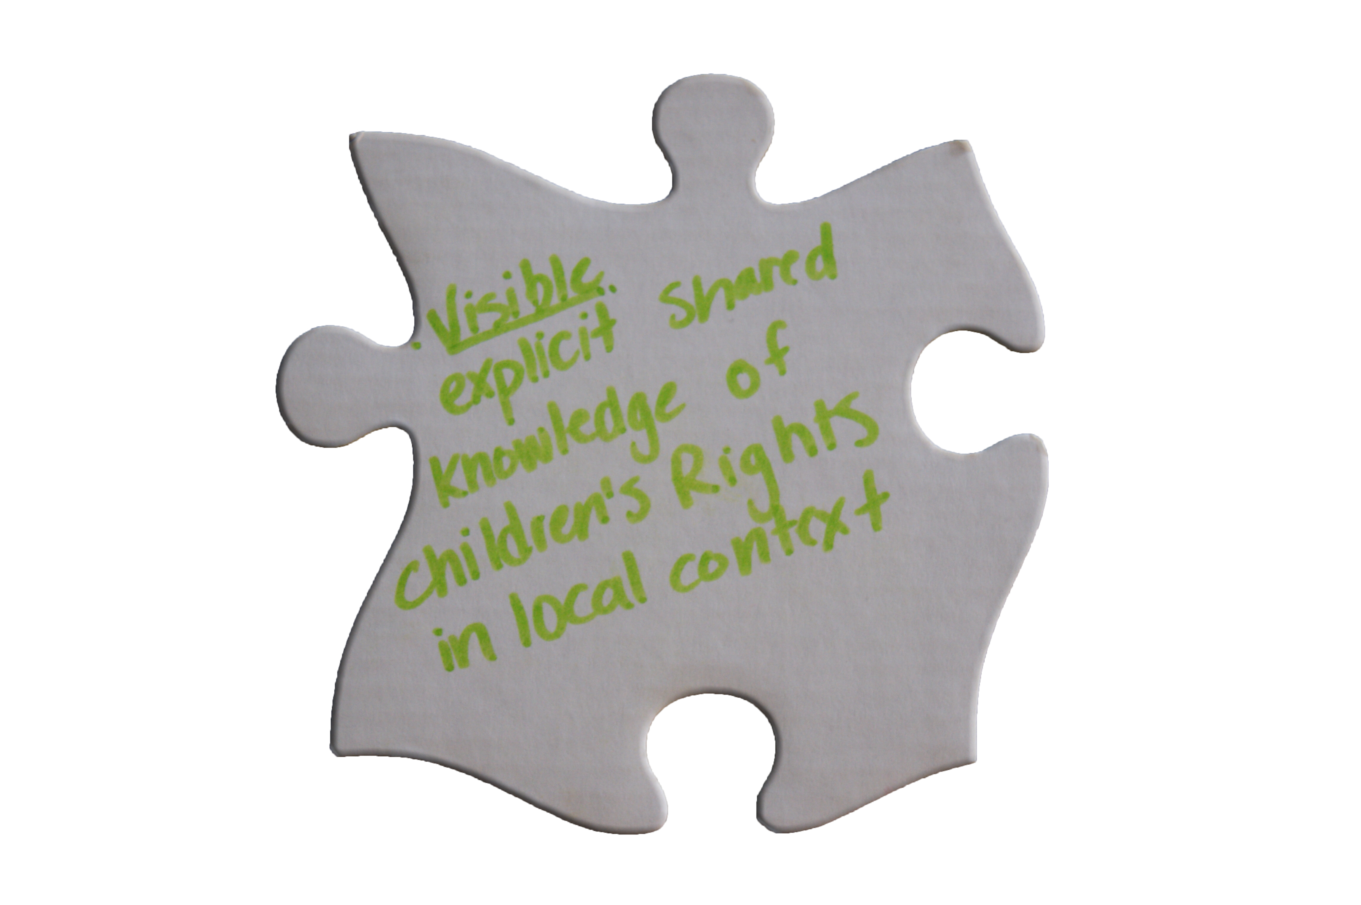
Tri-Cities Children’s Charter Of Rights
Working together across the multiple sectors to afford children their rights
#TRICITIESCHILDRIGHTS

Slide 2
“Build a better community, one that is inclusive, especially of people who are vulnerable and isolated. Start with talking to your neighbours.”
Angelo Lam

Slide 3
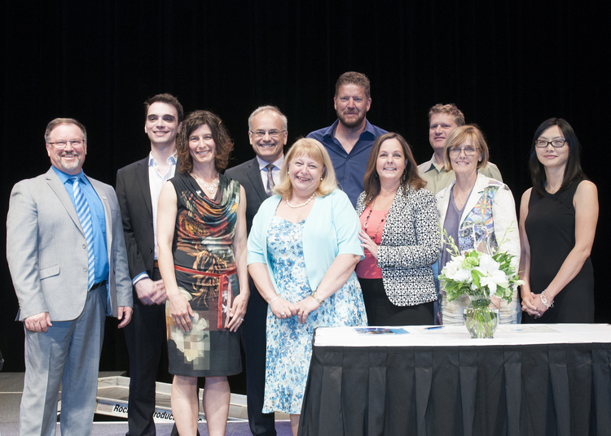
Tri-Cities Children’s Charter of Rights
Our Accord Partners, known then as Early Childhood Public Partners, signed the Tri-Cities Early Childhood Development Community Accord in 2011.
The document affirms their recognition of the importance of supporting early childhood.

Slide 4
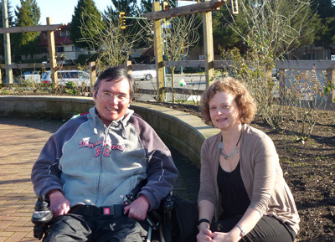
Tri-Cities Children’s Charter of Rights
After some collaborative work was done on child rights, Susan Foster and Angelo Lam presented the Tri-Cities Charter of Rights to discuss the possibility of including the Charter in the Accord.
The idea was favourably received by our Accord Partners. It now allows us to work together across the multiple sectors to afford children their rights.
Thank you Angelo & Susan!

Slide 5

It began in 2014…
The journey towards the creation of a Tri-Cities Children's Charter of Rights began with distributing an invitation to a community visioning event in 2014.
This was an opportunity for the community to converge and discuss key questions about a Tri-Cities Children's Charter.

Slide 6
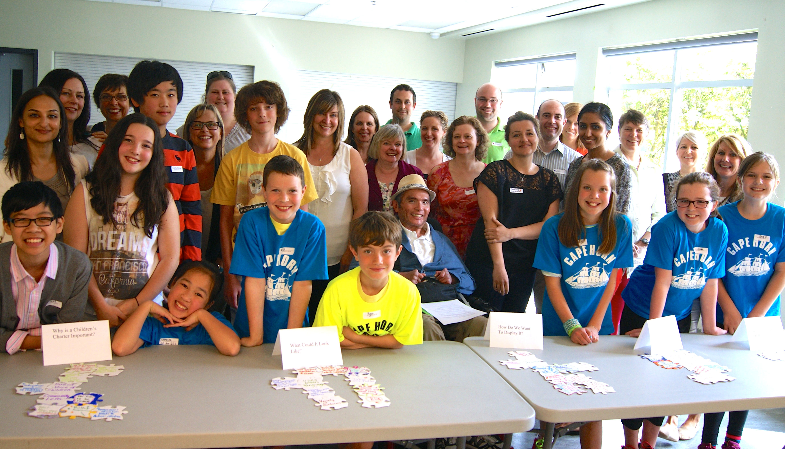
Visioning Event, April 2014
The Tri-Cities Children's Charter Community Visioning Event provided the community an opportunity to discuss 5 key questions. The priorities identified at the Visioning Event set the direction for the next steps in the Tri-Cities Children's Charter of Rights initiative.

Slide 7
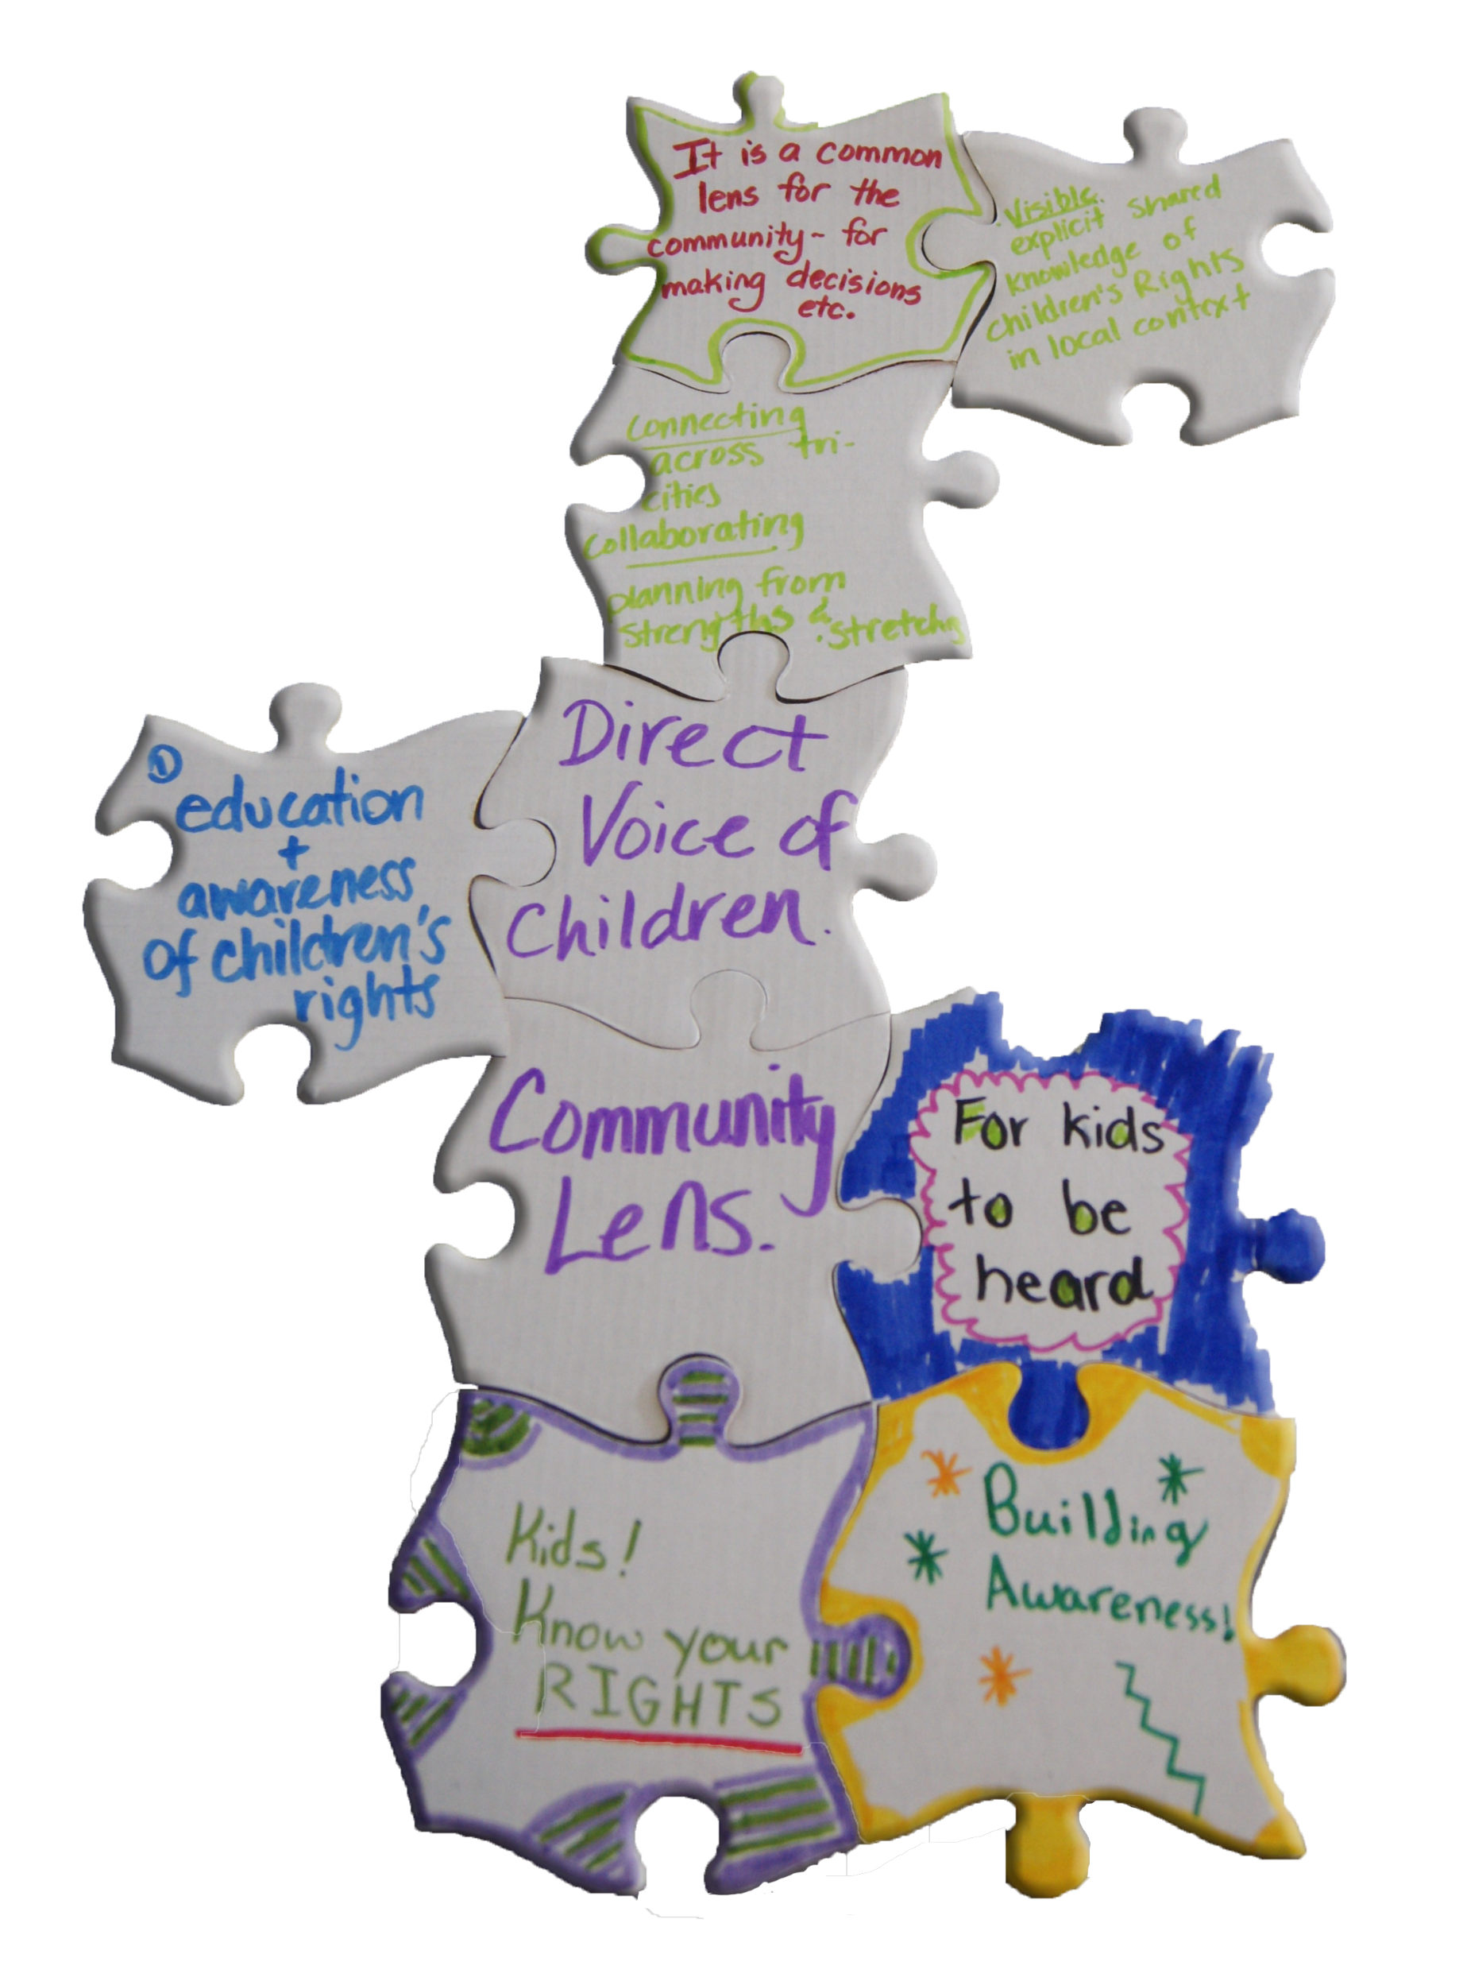
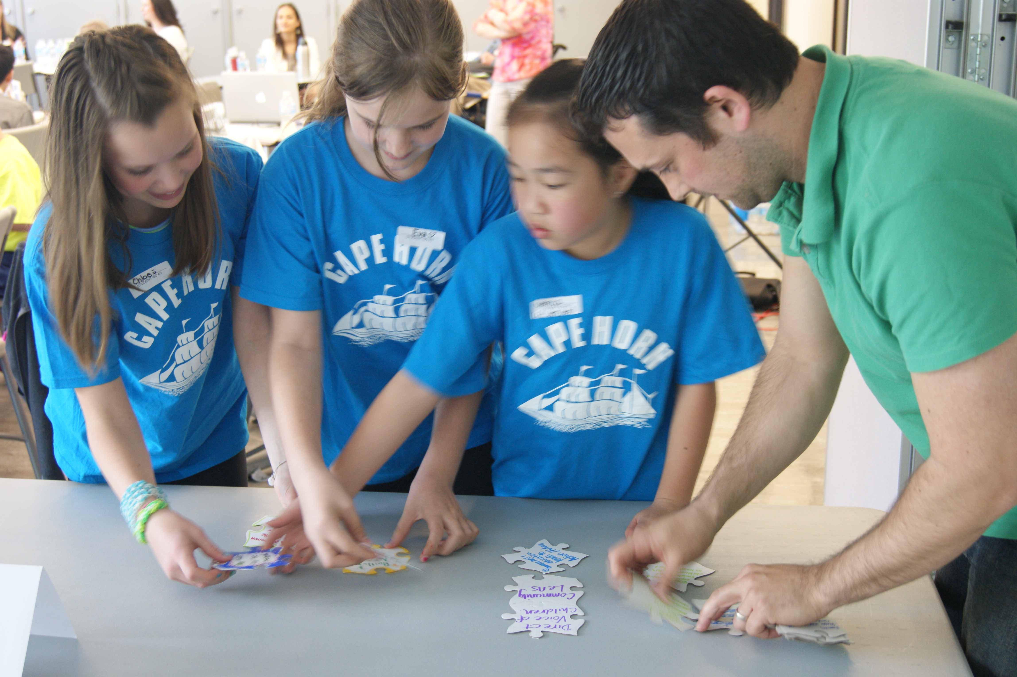
Visioning Results
(1) Why is a Children’s
Charter important?

Slide 8
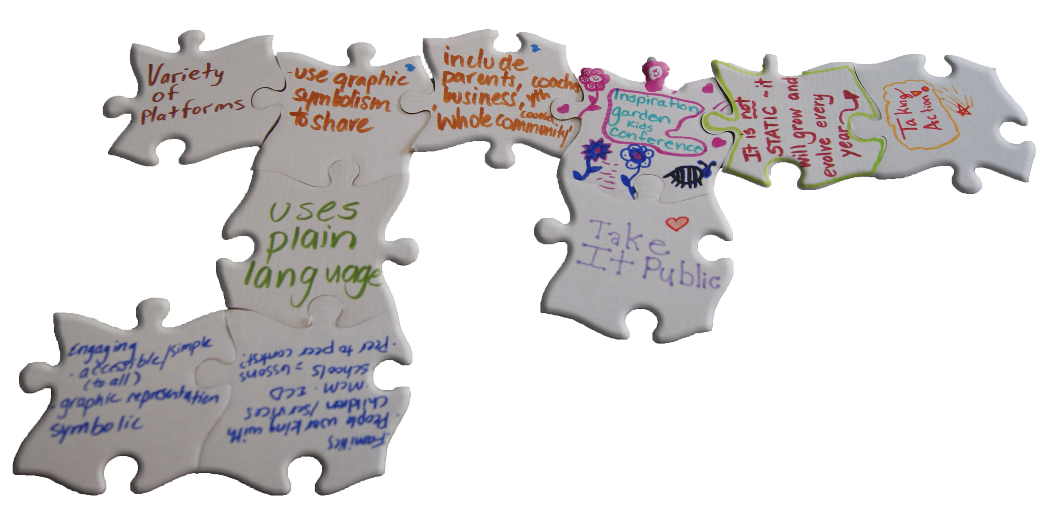
Visioning Results
(2) What could it look like?

Slide 9
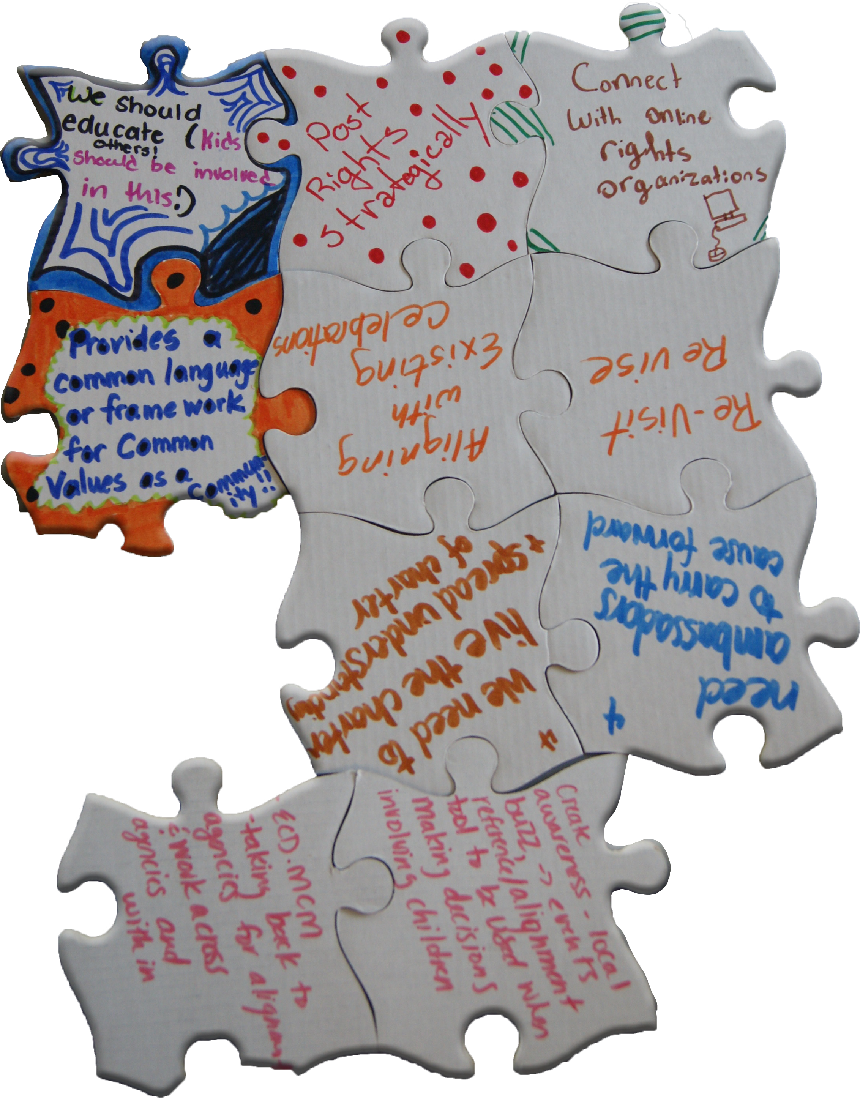
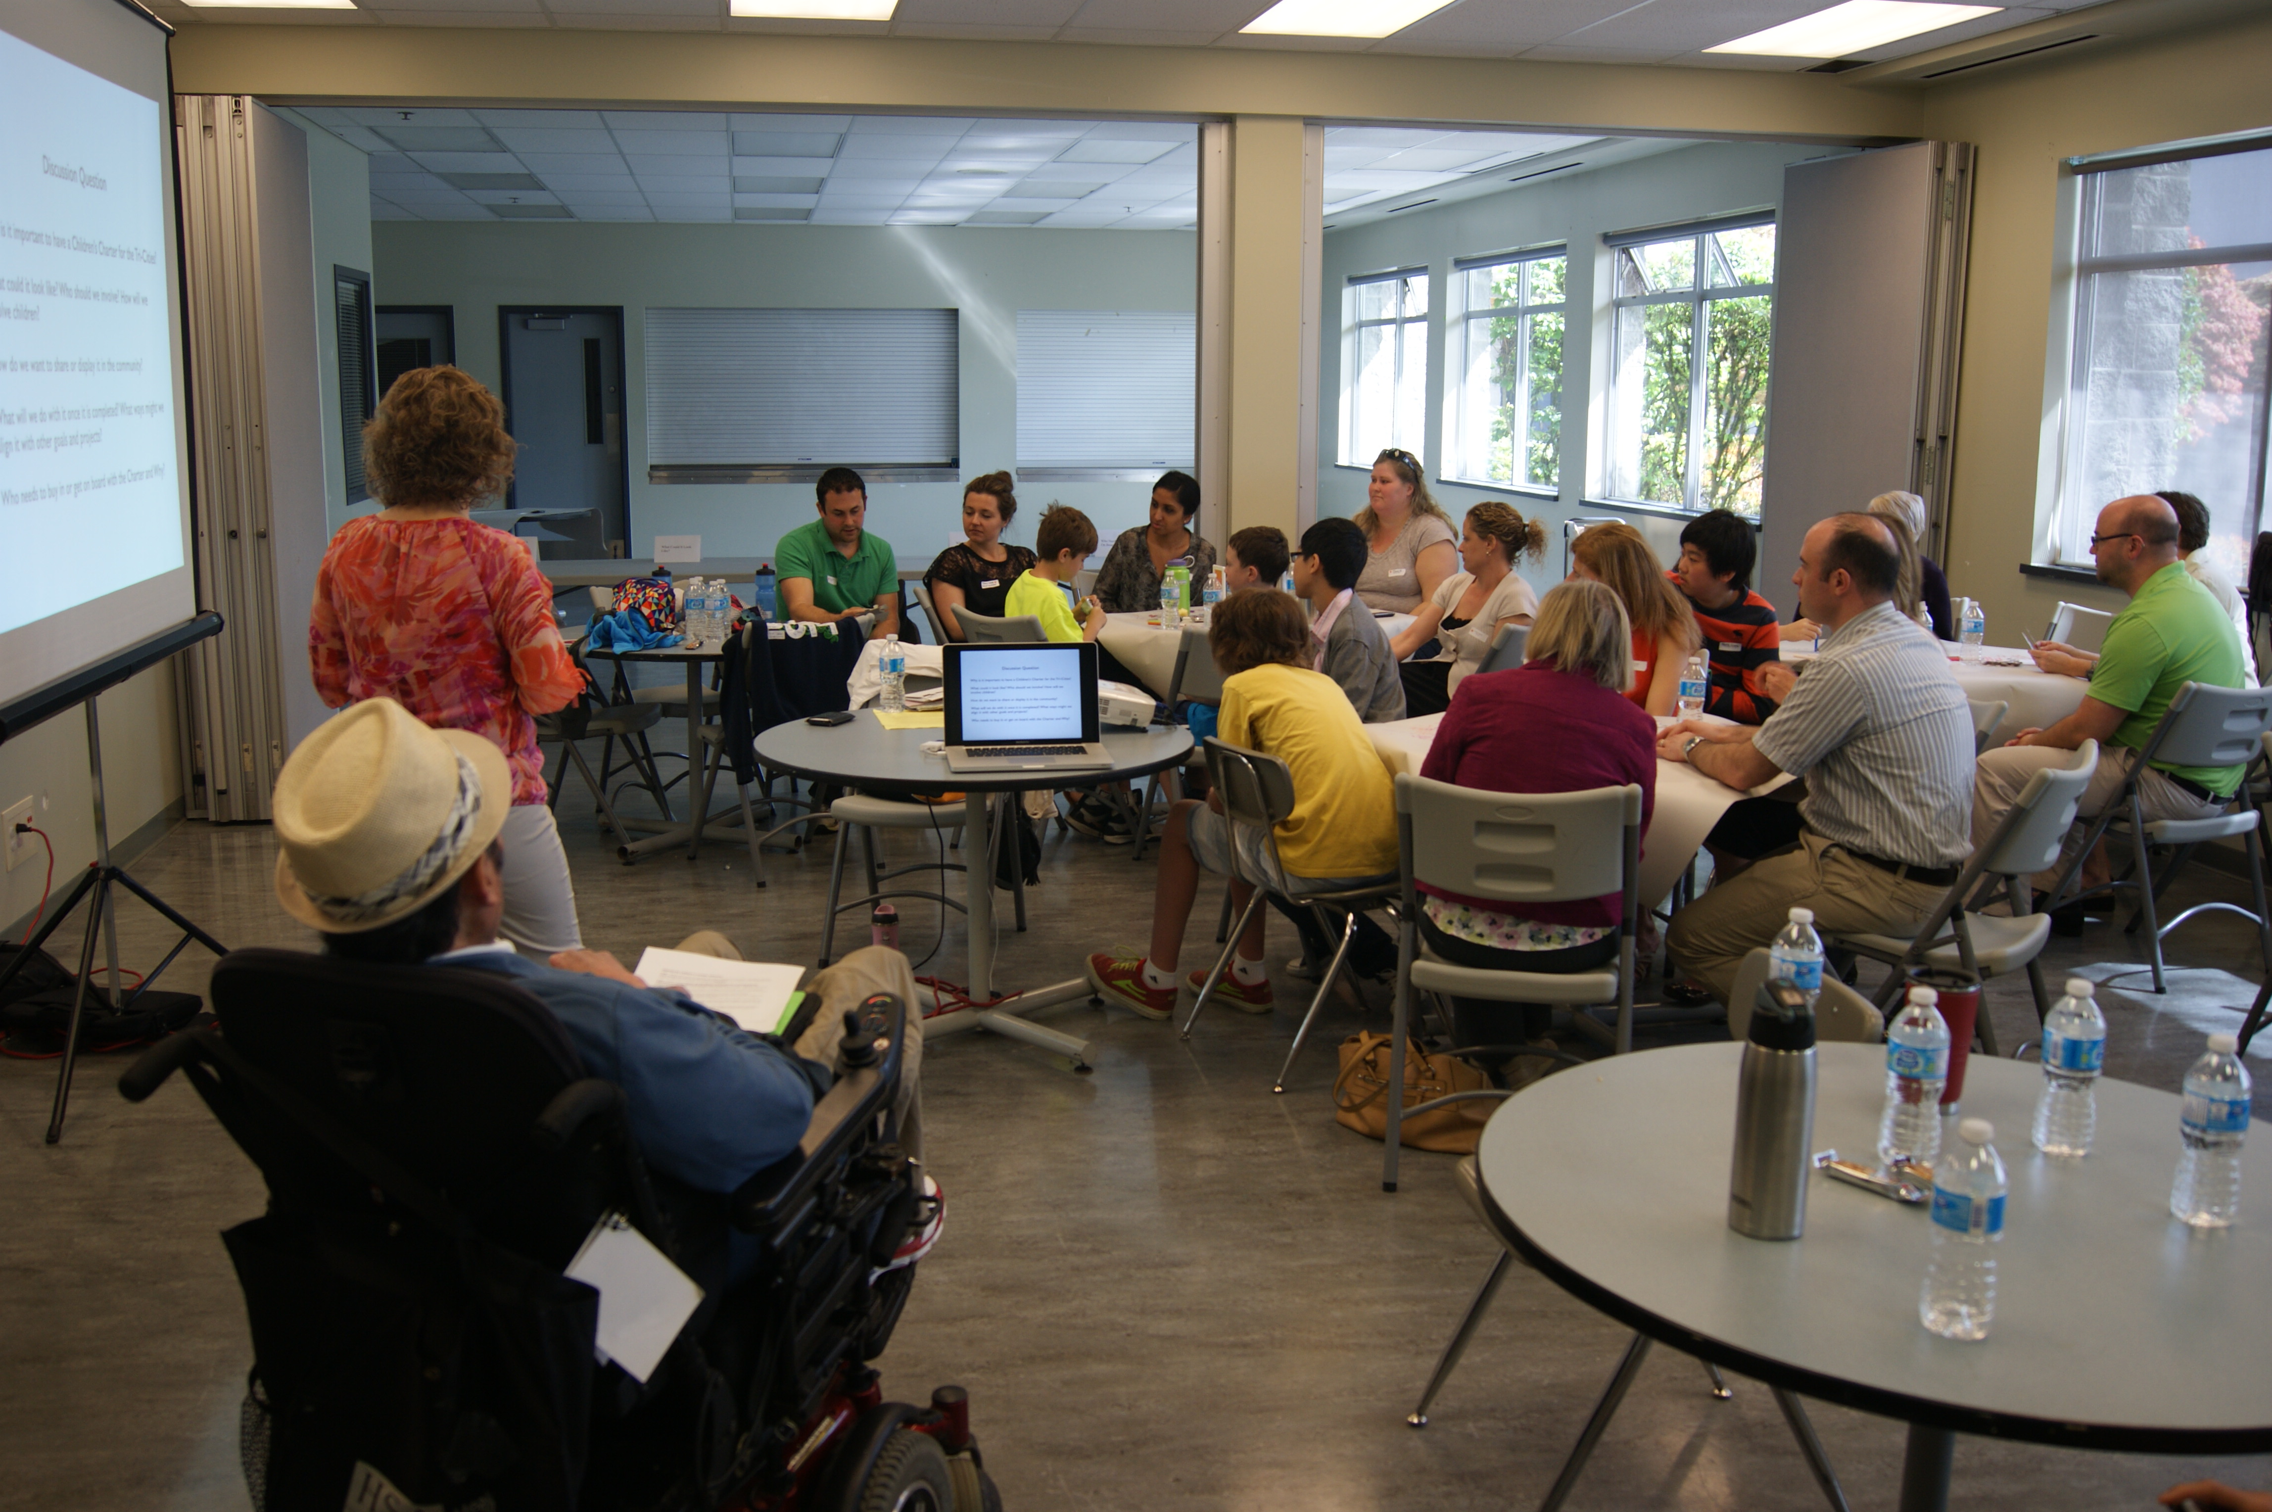
Visioning Results
(3) What will we do with it?

Slide 10
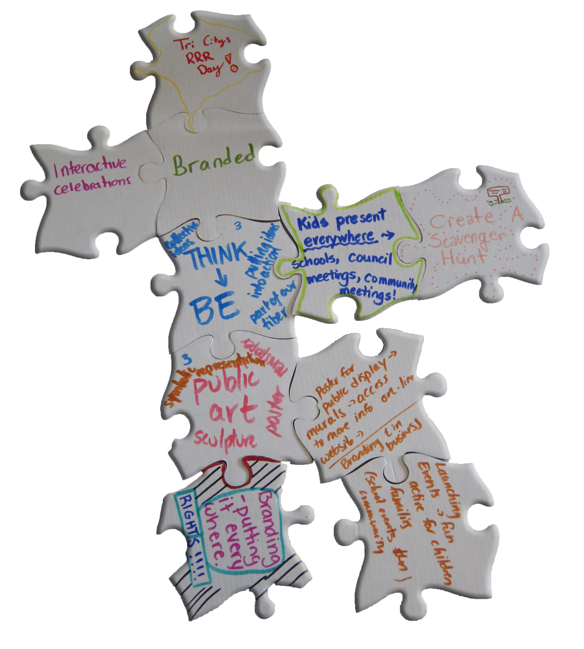
Visioning Results
(4) How will we display it?

Slide 11

Visioning Results
(5) Who needs to get on board?

Slide 12
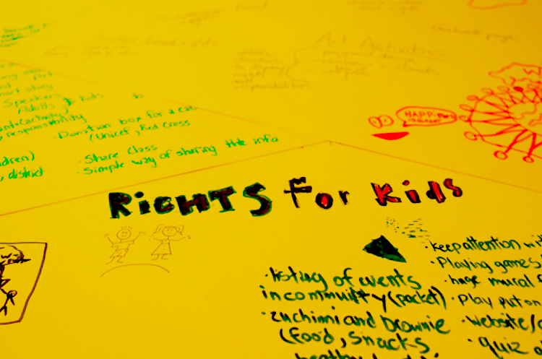
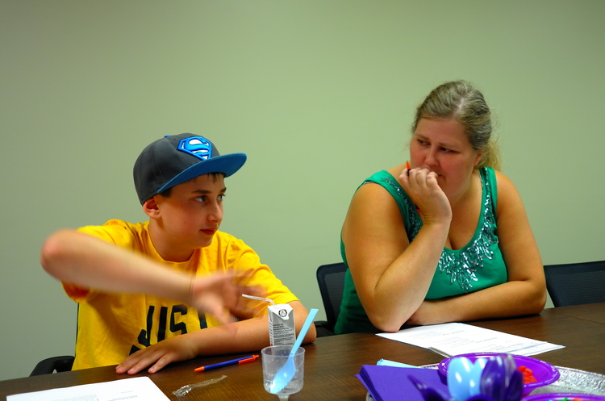
Kids Conference Planning, 2014
From July 2014 to November 2014, a series of planning meetings were held with School District 43 students and community organizations to create the first ever Tri-Cities Kids Conference.
The conference was in celebration of the 25th anniversary of the United Nations Convention on the Rights of the Child. The theme of the conference was "Pass It On! Be A Rights Champion".

Slide 13
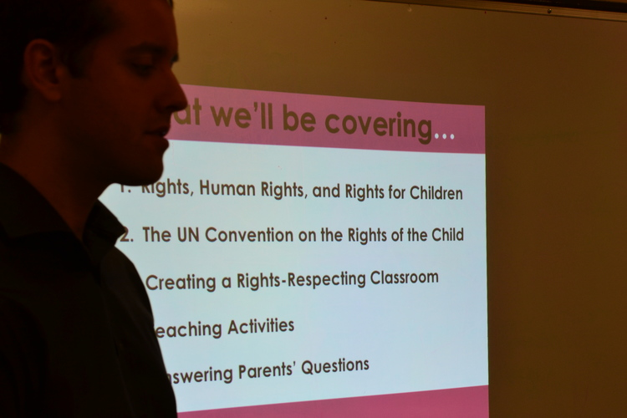
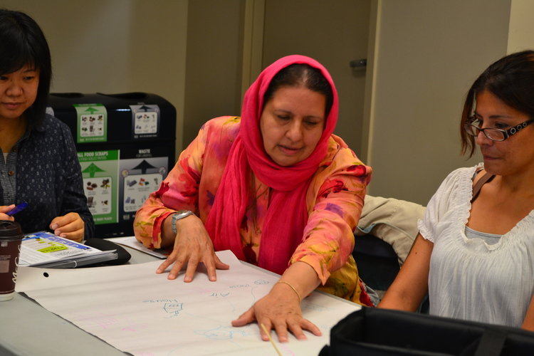
Child Rights Training Day, September 2014
Organizations working with children 0-12 years of age in the Tri-Cities were invited to participate in workshops facilitated by our partners, Equitas-International Centre for Human Rights Education and Society for Children and Youth of BC.

Slide 14
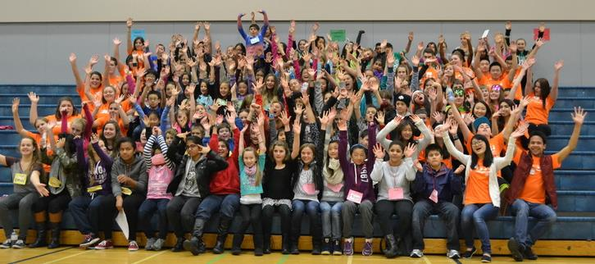
Tri-Cities Kids Conference, 2014
The 2014 Tri-Cities Kids Conference was a huge success!
Participants at this high energy conference learned a lot about child rights and returned to their school as "Rights Champions".

Slide 15

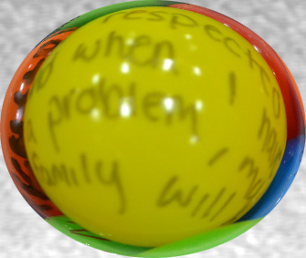


Gathering Children's Voices
Between November 2014 and March 2015, we collected the thoughts and ideas of children ages 2-12 living in the Tri-Cities.

Slide 16
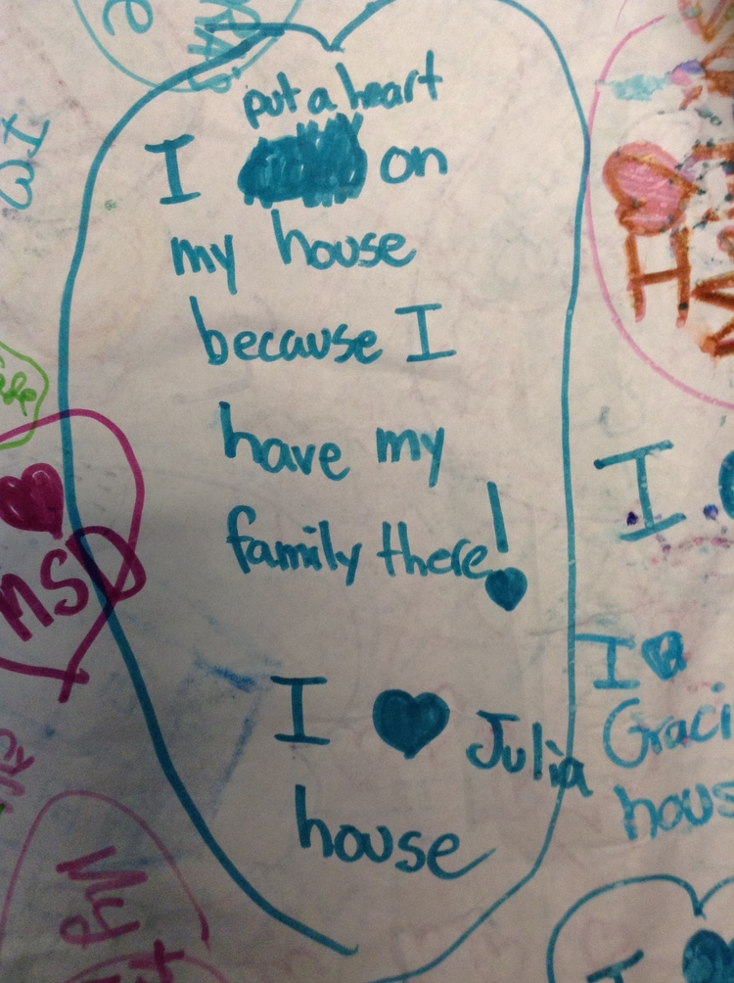
Gathering Children's Voices
They shared about:
what they loved
what they wish could be different
what they wanted
what they needed

Slide 17
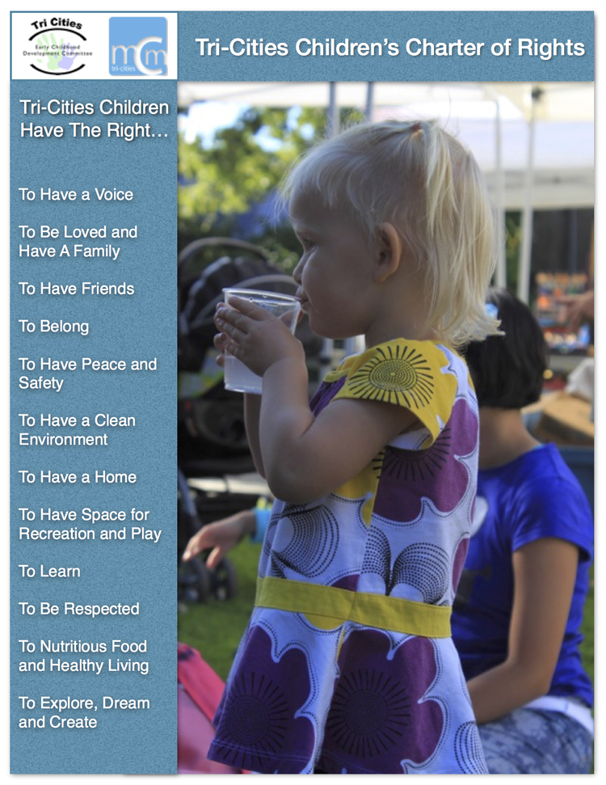
Creating the Rights
From all the information collected, themes emerged that became the elements of the draft of the Tri-Cities Children's Charter of Rights.
On May 21, 2015 the draft of the Tri-Cities Children's Charter of Rights was unveiled at the Tri-Cities Champions for Young Children Awards of Excellence Event.

Slide 18
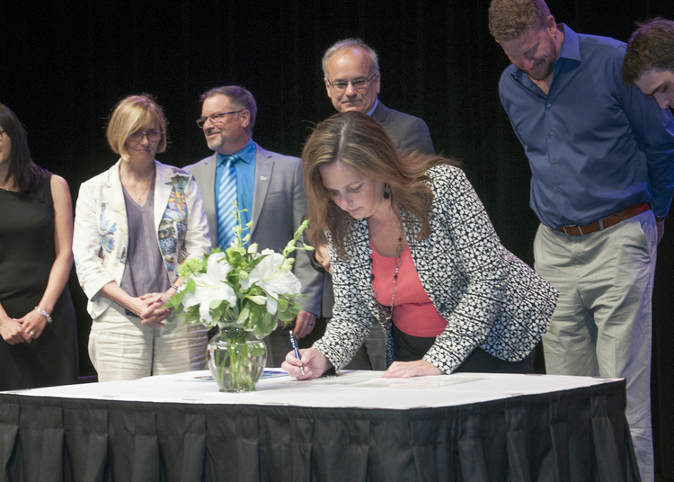
Signing of Tri-Cities Children's Accord & Children's Charter
On May 12, 2016, the Tri-Cities Children's Accord (including the Tri-Cities Children's Charter of Rights) was signed in front of over 180 people at the 7th Annual Tri-Cities Champions for Young Children Awards of Excellence Event.

Slide 19
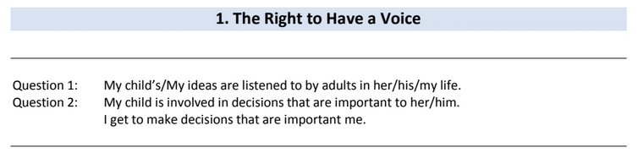
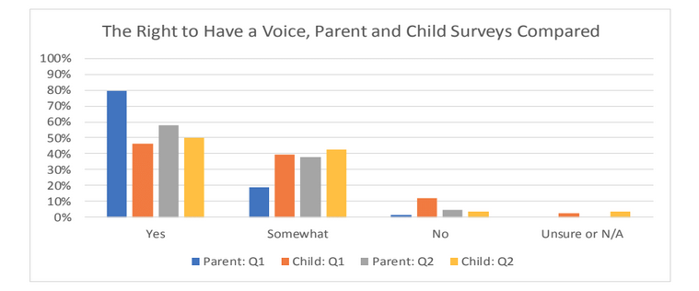
Addressing the Rights
In 2017, parents, children aged 2 – 12 and our partners were surveyed to find out how well the 12 Rights were being addressed.

Slide 20
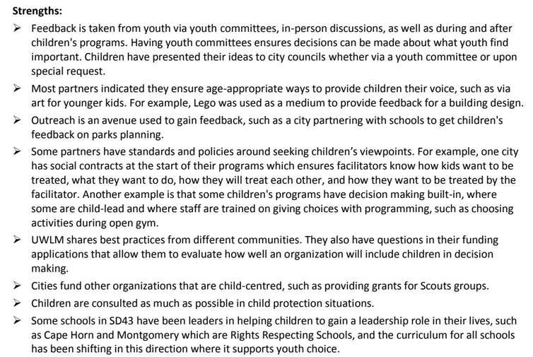
Addressing the Rights
We learned just how much our community is already doing to address all 12 Rights.
On November, 2017, we presented a summary of the survey results to the Accord Partners. Together, we chose 4 main Rights that we felt could use our focused attention.

Slide 21
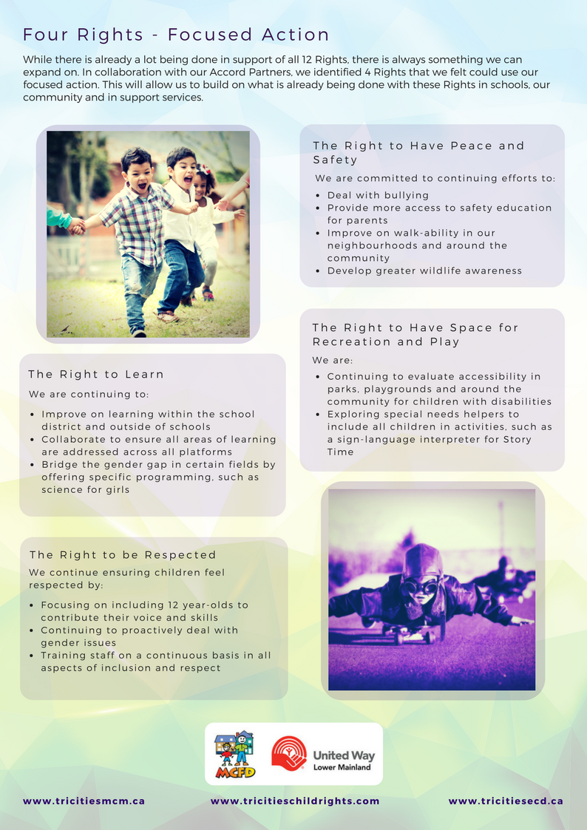
Action Plan
The Tri-Cities Children Charter of Rights allows us to work together across multiple sectors to afford children their rights.
The 4 Rights we identified to take more action on are:
The Right to Have Peace & Safety
The Right to Learn
The Right to Have Space for Recreation & Play
The Right to be Respected

Slide 22
Thank you, Accord Partners
Thanks to all of the Early and Middle Childhood Public Partners for agreeing that the Early and Middle Childhood Years (birth to 12 years) are critical in the healthy development and future well-being of children in our communities.
Fraser Health Authority (Public Health), Tri-Cities
Ministry of Children & Family Development, Tri-Cities
Board of Education, School District #43, Coquitlam
Village of Anmore
Village of Belcarra
City of Coquitlam
City of Port Coquitlam
City of Port Moody
Coquitlam Public Library
Port Moody Public Library
Terry Fox Library, a member of Fraser Valley Regional Library
United Way of the Lower Mainland

Slide 23
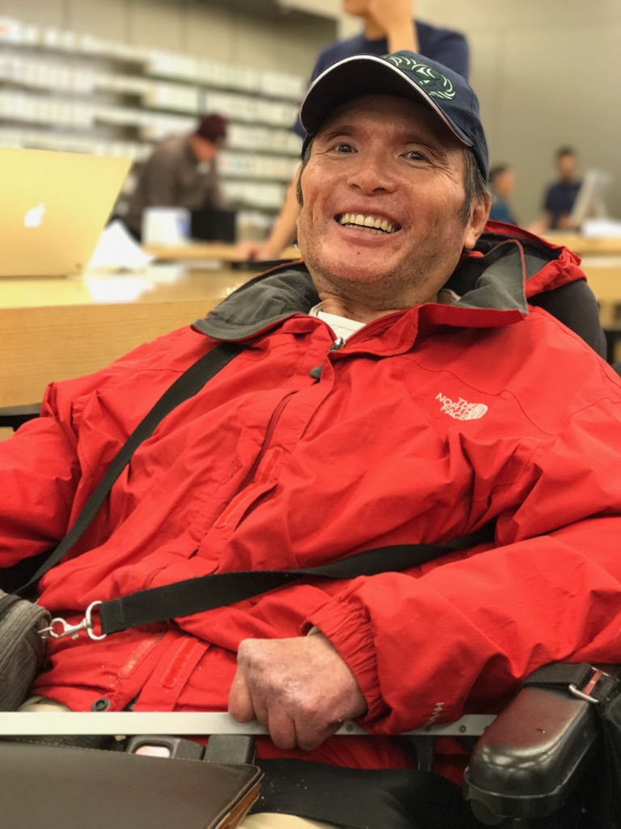
Thank you,
Angelo Lam
Angelo was a true Children’s Champion. With the support of Susan Foster and multiple community partners, he was instrumental in bringing the Children’s Charter of Rights to the Tri-Cities in a way that fosters collaboration, respect and dedication in our community.
May we continue along the path he paved for the success of our children.

Slide 24
#TRICITIESCHILDRIGHTS
Spread the word via your social media outlets that
#TRICITIESCHILDRIGHTS
matter!

Slide 25



Tri-Cities Children’s Charter of Rights
The Tri-Cities Children’s Charter of Rights initiative is a collaboration of the Tri-Cities Early Childhood and Tri-Cities Middle Childhood Committees. The two committees consist of a cross-section of individuals, service providers, and representatives from different levels of government, from the Tri-Cities Community with an interest in the healthy development of children in early childhood (0-6) and middle childhood (6-12), community partnerships and the vision of the committee.
This initiative has led to the creation of a Tri-Cities Children’s Charter of Rights, which is included as an appendix to the Tri-Cities Children’s Accord, that we hope will help inform policies, programs and services for children 0-12 and their families. Financial support for this initiative is provided by the Ministry of Children and Family Development , and the United Way of the Lower Mainland.
www.tricitiesmcm.ca www.tricitieschildrights.com www.tricitiesecd.ca

